Slide 1
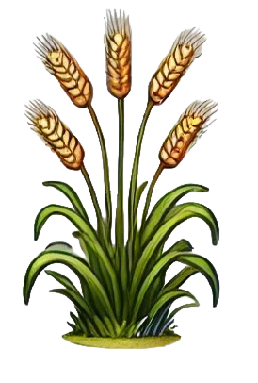
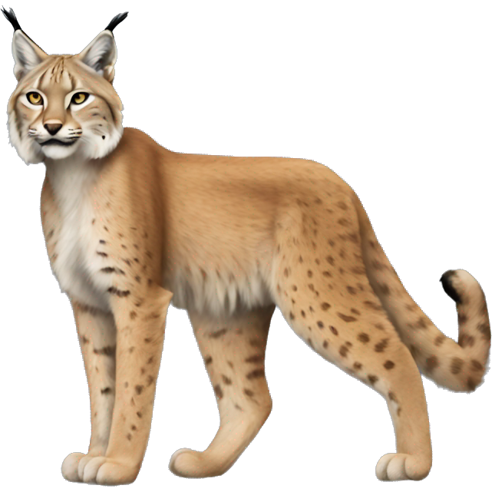
Plants & Animals
TEACHER‘S GUIDE
FOR SCHOOLS AND GROUPS

Slide 2
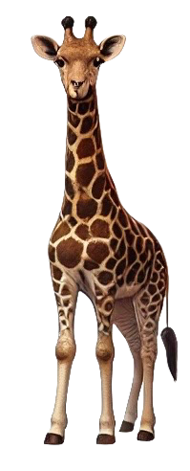
CONTENTS
General Guidelines
Matching Game
Expansion Ideas
Expansion Ideas

Slide 3
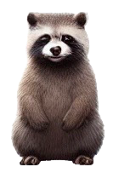
GENERAL GUIDELINES

Slide 4
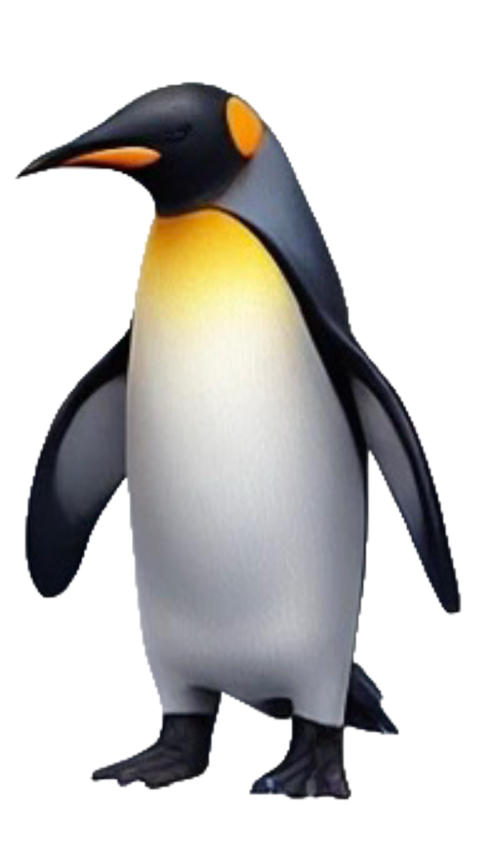
Activity Overview
Activity Duration
The activity lasts 20-25 minutes and can be extended with creative exercises. It focuses on animal and plant vocabulary, habitat descriptions, behavioral verbs, and descriptive adjectives, providing an engaging way to learn Latin through nature.
Class Format
The activity works well in small groups (2-4 students) or pairs. Students collaborate to match animals with habitats, describe their features, and create nature narratives. A whole-class sharing session concludes the activity.
Learning Objectives
Students will learn to describe animals and plants using Latin adjectives, identify natural habitats with prepositional phrases, use genitive and ablative cases for description, and construct sentences about the natural world.

Slide 5
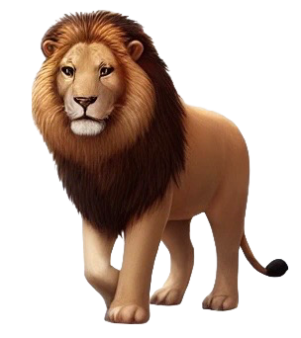
Preparation Steps
Materials Needed
Teachers need to print animal/plant cards, habitat cards, and word banks of adjectives and verbs. Prepare enough sets for groups of 2-4 students. Optional: images of animals/plants, and habitats for visual support.
Setup Instructions
Distribute card sets to each group. Keep animal/plant cards and habitat cards in separate stacks face-down. Provide word banks for adjectives and prepositional phrases. This setup encourages collaborative learning and discovery.

Slide 6
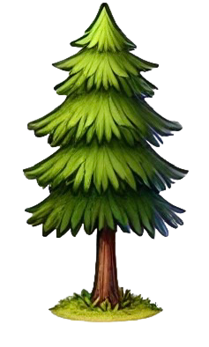
Demonstration and Instructions
Live Demonstration
Sentence Building
The teacher demonstrates matching an animal to its habitat: "Lupus in silva habitat. Lupus est animal ferum et nocturnum." Show how to build from simple to more complex sentences with multiple adjectives.
Start with simple sentences: "Ursus in spelunca dormit." Progress to adding characteristics: "Ursus magnus et validus in spelunca obscura hieme dormit." Encourage creativity and accuracy.
Group Roles
Optional Extensions
Assign roles: one student draws animal cards, another draws habitat cards, a third consults the word bank. Rotate roles after each round to ensure equal participation and different perspectives.
Add behavioral verbs (pascitur, venatur, volat), seasonal information (vere, hieme, aestate), food chains (leo cervum venatur), or comparative sentences (Lupus velocior est quam ursus).

Slide 7
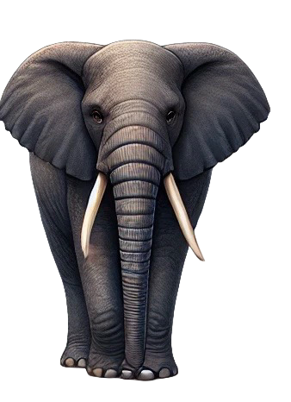
Whole-Class Sharing
Volunteer Presentations
Grammar Reinforcement
Invite three volunteer groups to present their best animal-habitat descriptions. The class listens and identifies the animal being described. This reinforces vocabulary and develops listening comprehension skills.
Highlight correct adjective agreement (ferus, fera, ferum), prepositional phrases (in silva, sub terra), case usage, and creative vocabulary choices. Praise accurate biological knowledge and Latin expression.

Slide 8
MATCHING GAME

Slide 9
Animal Coverings, Behaviour, and Sounds
1
2
3
Fur, feathers, or scales?
Barking or Meowing?
Grammar Practice
Students practice animal coverings by sorting animals into three categories: mammals with fur (lupus, ursus, vulpes), birds with feathers (aquila, corvus, passer), and reptiles/fish with scales (serpens, lacerta, piscis). Use the question "Quid tegit…?" and teach responses: "Pilus/villus tegit…" "Pluma tegit…" "Squama tegit…."
Students learn animal sounds by matching Latin verbs to animals: lupus ululat, canis latrat, equus hinnit, bos mugit, and so on. Practice with the question "Quid animal dicit?" or "Quomodo animal sonat?" and have students perform the sounds while saying the Latin verb.
Build upon previous matching animals to habitats using prepositional phrases with ablative (in silva, sub terra) by adding movement and direction with accusative (ad flumen, trans mare). Students practice adjective-noun agreement across all declensions.

Slide 10
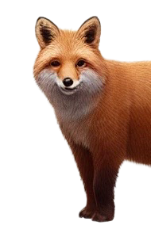
Animal Behavior & Characteristics
Behavioral Verbs
Practice verbs: habitat (lives), venatur (hunts), pascitur (grazes), dormit (sleeps), volat (flies), natat (swims), currit (runs), ululat (howls). These verbs create vivid descriptions of animal life and behavior.
Descriptive Adjectives
Biological Accuracy
Use adjectives: ferus (wild), mansuetus (tame), nocturnus (nocturnal), velox (swift), validus (strong), parvus (small), magnus (large). These enable rich descriptions while practicing adjective declension patterns.
Encourage students to combine Latin learning with natural science. Discuss real animal behaviors, habitats, and characteristics in English, adding Latin terms wherever approapriate. This creates memorable connections between vocabulary and scientific knowledge.

Slide 11
EXPANSION IDEAS

Slide 12
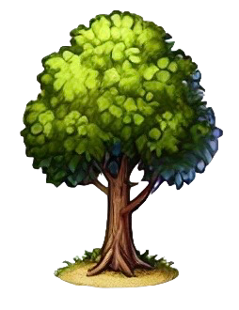
Challenge Variations for Advanced Learners
Food Chains
Nature Narratives
Seasonal Changes
Create predator-prey relationships: "Leo cervum venatur. Cervus herbam edit. Herba in campo crescit." This chains sentences together and practices accusative objects with transitive verbs.
Encourage students to create multi-sentence stories about a day in an animal's life using past tenses: "Lupus mane e spelunca venit. In silva cervum vidit. Cervum diu secutus est. Tandem cervum non cepit." This develops narrative skills and facilitates the acquisition of natural, fluent language skills.
Describe how animals behave differently across seasons: "Vere aves nidos aedificant. Aestate ursus piscatur. Autumno aves migrant. Hieme ursus in spelunca dormit." Practice temporal phrases and seasonal vocabulary, including types of weather.

Slide 13
THANKS!
Homo Legens
2025

