Slide 1

Cleaning the House
Homo Legens
2025

Slide 2


01
Teacher’s Guide
02
Floor Plan
CONTENTS
03
Item Cards
04
Expansion Ideas

Slide 3

PART 01
Teacher’s Guide

Slide 4
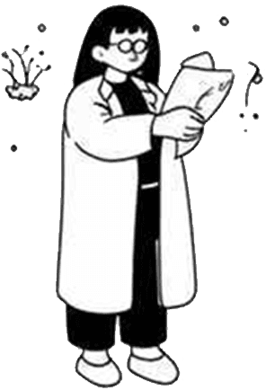
Activity Overview
Activity Duration
The activity is designed to last 15-20 minutes, but it can be extended for more practice. It focuses on Latin imperatives, household vocabulary, sequence words, and providing a dynamic way to engage students in language learning.
Class Format
The activity is best conducted in pairs with role-switching to ensure active participation. It culminates in a quick whole-class check to reinforce learning and correct any misunderstandings.
Learning Objectives
Students will learn to give and follow 2-3 step commands using imperatives, specify locations using place phrases, and add sequence steps using connectors like prius, deinde, and postea.

Slide 5

Preparation Steps
Materials Needed
Teachers need to print the floor plan in several copies and cut out enough item and verb/phrase cards. Shuffle them into separate stacks for ITEMS and VERBS/PHRASES to ensure a variety of commands.
Setup Instructions
Distribute the floor plans and activity cards to student pairs. Keep the stacks face-down to maintain randomness. This setup encourages spontaneous language use and interaction.

Slide 6

Demonstration and Instructions
Live Demonstration
Repetition and Echo
The teacher demonstrates a command chain, such as 'Collige lintea et in armario depone,' while miming the actions. This helps students visualize the commands.
Encourage the class to echo the commands to establish correct pronunciation before pairs begin their practice. This reinforces oral skills.
Role Assignment
Optional Steps
One student acts as dominus / pater / mater, and the other as famulus / filius / filia. After a round, they change the roles to ensure equality and use the cards to the maximum.
Optional steps include introducing sequence connectors (prius, deinde, and postea) instruments (spongia, scopae, penicillus), or even reasons such as … quia sordidus / -a / -um est.

Slide 7

Whole-Class Check
Volunteer Participation
Grammar Reinforcement
Invite three volunteer pairs to read their best three-step command aloud. The entire class performs the actions simultaneously, ensuring everyone is engaged.
Highlight correct imperative endings, prepositional phrases, and connector usage. Praise creative additions like reasons with quia or instruments in the ablative case.

Slide 8
PART 02
Floor Plan

Slide 9
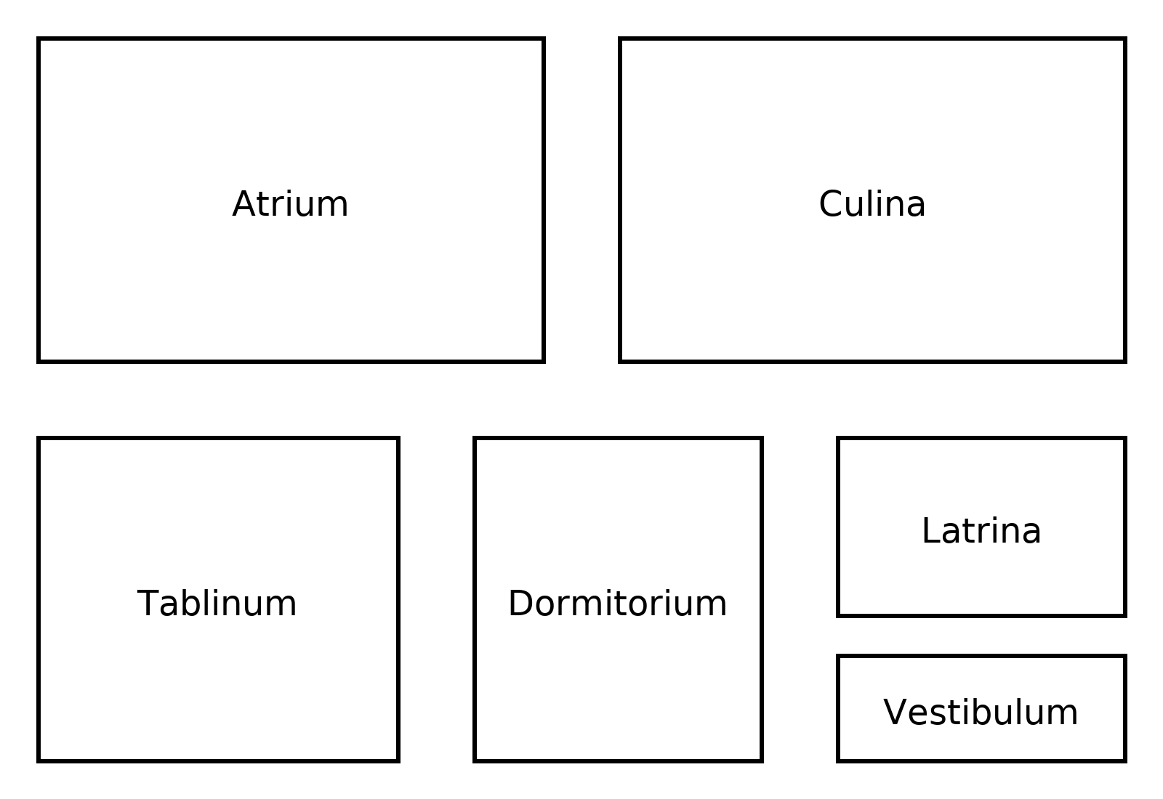
Floor Plan Sample
Room Labels

Slide 10
PART 03
Item Cards

Slide 11

Storage Furniture Items
1
2
Heavy Objects
Grammar Practice
List Latin item cards: armarium (wardrobe), mensa (table), scrinium (book box), arca (chest). These are heavy or fixed objects, often paired with pone or depone.
Commands involving these items reinforce second declension neuter endings and locative phrases, providing valuable grammar practice.

Slide 12
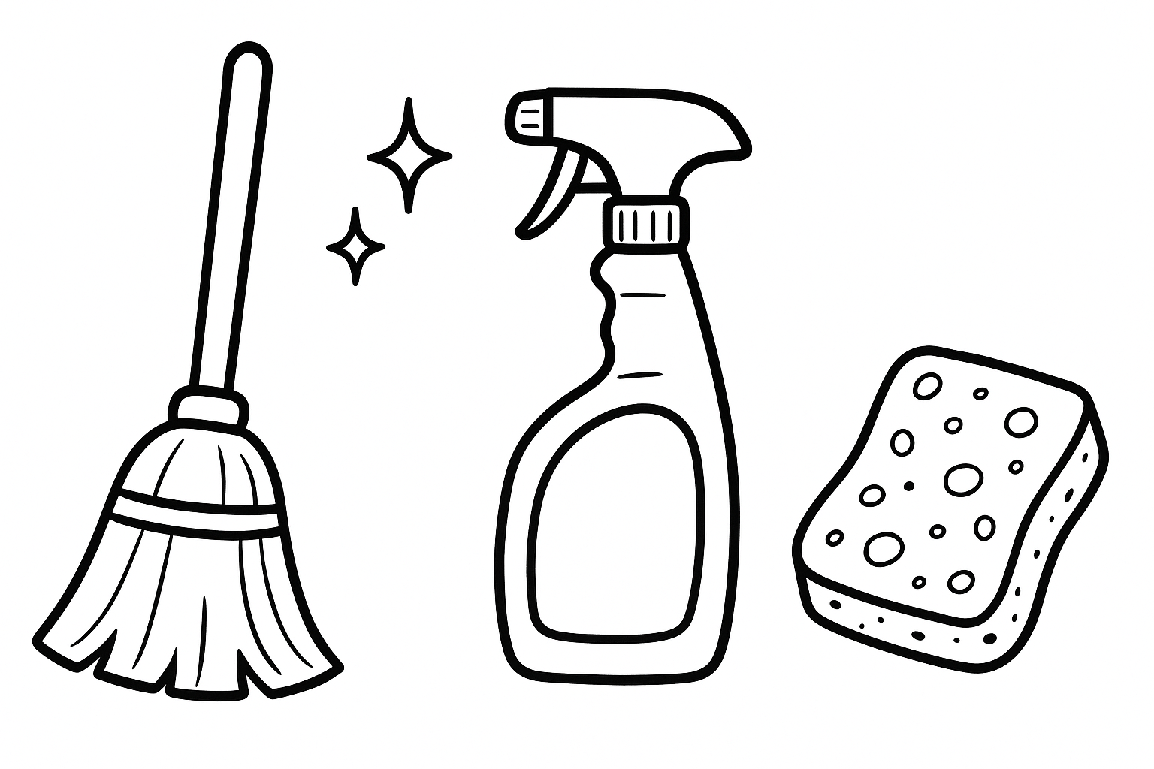
Cleaning Tools
Tools for Chores
Present linteum (cloth), spongia (sponge), pannulum (small rag), corbis (basket), scopae (broom), situla (bucket). These tools invite imperatives like terge, lava, elue, collige.
Third Declension Practice
Cultural Relevance
These items enable practice of third declension feminine and plural neuter forms, enhancing students' understanding of Latin noun cases.
Add some Neo-Latin vocabulary (machina lavatoria, aspiratorium pulveris) to actualize the situations and induce an a-ha moment showing Latin as a living language.

Slide 13
PART 04
Expansion Ideas

Slide 14



Challenge Variations for Advanced Learners
Multi-Room Quests
Planning Future Actions
Past Actions
Invent multi-room quests, for example: one student chains five commands to finish a cleaning routine, while the other performs the tasks by placing the cards in appropriate rooms and telling aloud what they are doing.
Imagine the cleaning routine took place yesterday. One student narrates the actions in the past (Perfect for completed actions, Imperfect for incomplete ones), the other repeats the sentences in third-person.
Diagnose the state of the household – what needs to be done? Use gerundive to assess the situation, then distribute the tasks to various household members in imperative or future tense.

Slide 15

THANKS!
Homo Legens
2025

